Slide 1

Bringing Data Files into Tableau
Data Visualisation

Slide 2
Overview
Links on Moodle to help you convert your data files.
  Tableau Resource - Tips for Working with Your Data
  Reshaping Excel Plugin

Slide 3

Finding your Dataset
It takes time,
a lot of time!!!!

Slide 4
Finding your Dataset
Count your columns
Count your rows
Ideally, find several data sets that are related
  Related by topic – Ice Cream Sales and Weather stats
  Inside the dataset - same countries, counties, years etc. (to link them)
Do not create your own!
  Copy and paste may be OK
But of course you can modify what you find
Spend a lot of time formatting your data before the cleaning process

Slide 5

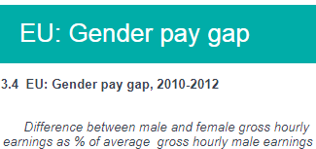
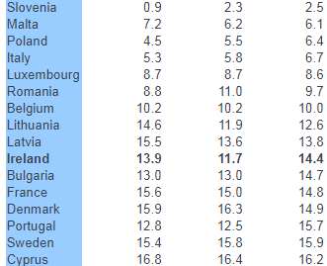
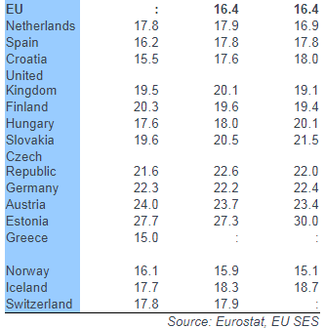
I found a Data set
Notes:
http://www.cso.ie/en/releasesandpublications/ep/p-wamii/womenandmeninireland2013/socialcohesionlifestyleslist/socialcohesionlifestyles/#d.en.65537

Slide 6
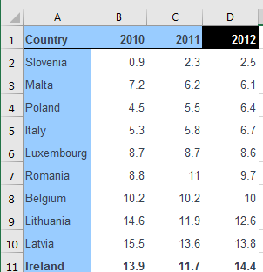
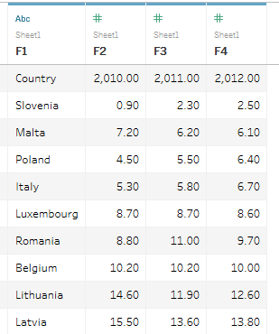
I found a Data set
Take a sample and bring it into Tableau

Slide 7
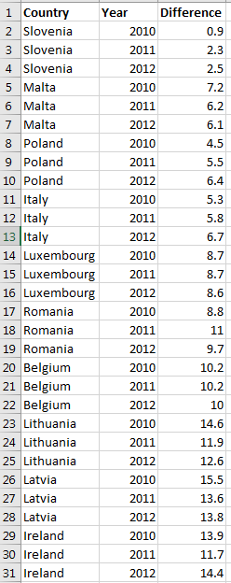
I found a Data set
Convert it to the right format that
Tableau can work with

Slide 8
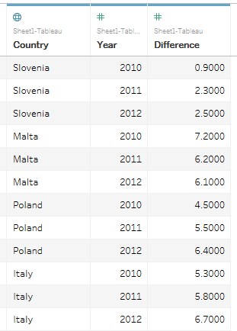
I found a Data set
Convert it to the right format that
Tableau can work with

Slide 9
Recommendations from Tableau
Once you have found a data set,
ensure that you have done the following

Slide 10

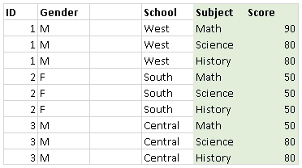
Tableau Desktop is optimized to connect to row-oriented tables

Slide 11
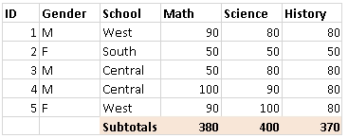
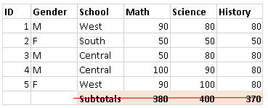
Remove pre-aggregated data
What about columns that contain a percentage?
I have a column that has age and another DOB. Do I need both?
Notes:
Calculate the percentage in Tableau. Data might change

Slide 12
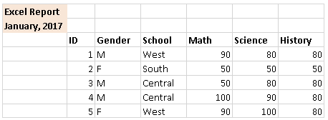
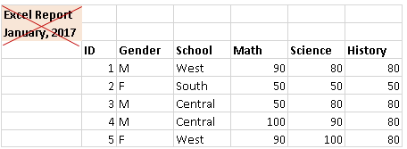
Remove or exclude introductory text
What about footnotes or other useful information that provides metadata?

Slide 13
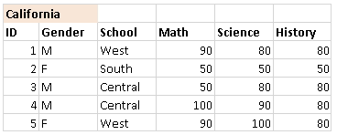
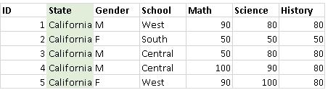
Flatten hierarchical headers to a single row
Tableau Desktop expects only the first row in your Excel data to contain column headers.

Slide 14
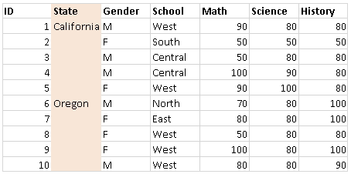
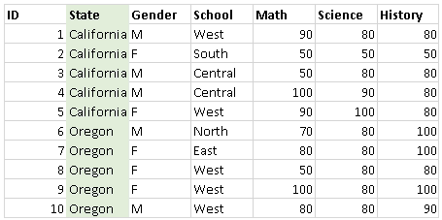
Make sure there are no blank cells

Slide 15
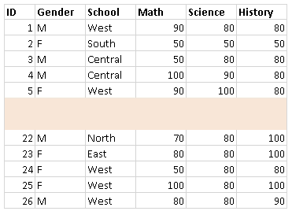
Remove blank rows

Slide 16
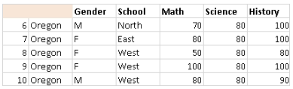
Add missing headers

